Slide 1

somavilivyo.com
KES 300 / 100 K tokens
2.3M Kenyan Students.
per student
$0.40
marginal cost
Zero personalised AI tutors.
5-to-1 return
Until now.
Revenue Share Partnership Proposal — March 2026
CONFIDENTIAL · SomaVilivyo © 2026 · Fredrick Kariuki & Axel Karambizi

Slide 2
THE PROBLEM
Kamau Studies Hard.
The System Fails Him.
2.3M
Secondary students in Kenya
With no personalised learning tool
Kamau is a Grade 9 student in Nairobi. His Chemistry teacher has 65 students in the class. His school has only 7 shared textbooks for the whole Form. He failed his mid-term not because he didn't study — but because there was no way to study effectively. He's one of 2.3 million Kenyan secondary and primary school students in the same position.
78%
Teachers lack CBC practice tools
KICD survey — curriculum still new
CBC creates Grade 6 & Grade 9 transition gates.
Parents are anxious. Teachers are unprepared. No platform is built for this.
KES 300
Monthly family spend on tuition
Per subject in Nairobi suburbs
CONFIDENTIAL · SomaVilivyo © 2026

Slide 3
WHY NOW
The CBC Window Is Open.
And It Won't Stay Open Long.
01
CBC is 3 years old
02
Grade 9 anxiety is peaking
No past papers. No proven revision tools. No dominant platform. The curriculum vacuum is real and current.
Students moving to Senior School in 2026-2027 have NO benchmarks. Parents are paying for anything that helps.
03
AI is finally affordable
04
No one is building this locally
Groq + Llama 3.1 = $0.40/student marginal cost. Two years ago this was impossible at this price point.
Khan Academy is US-aligned. Google Learn Your Way is too generic. SomaVilivyo is the only CBC-native AI platform.
CONFIDENTIAL · SomaVilivyo © 2026

Slide 4
THE SOLUTION
Kamau — Transformed.
BEFORE
AFTER
Shares textbook with 64 classmates
Zero personalised practice questions
Teacher cannot track his progress
Failing Chemistry mid-term
Generates CBC-aligned courses in 2 mins
Unlimited practice questions, any topic
24/7 AI tutor on KES 300/mo
23% average grade improvement
→
AI Course Generator
Question Library
24/7 AI Tutor
PDF Export
CBC-aligned, 11 templates, 2 mins to full lesson
Unlimited practice Qs, CBC performance levels
Knows your course, answers at 11pm
Download & study offline, no data needed
Platform live at somavilivyo.com — 70 active students, 380+ courses generated
CONFIDENTIAL · SomaVilivyo © 2026

Slide 5
TRACTION
Already Working.
Before This Funding.
70+
380+
23%
KES 300
Active Students
Courses Generated
Grade Improvement
Validated Price
Organic — no paid marketing
CBC-aligned content
Avg across pilot students
Students confirmed willingness
External Validation
✓ 3× AwardX Finalist (LaunchX)
✓ AwardX East Africa Winner (Axel / Libblio)
✓ Tonee Ndungu Mentorship (Kopo Kopo / Kytabu)
✓ Hummingbird Publishers MOU
✓ TUKO.co.ke Press Engagement
✓ somavilivyo.com domain live
CONFIDENTIAL · SomaVilivyo © 2026

Slide 6
BUSINESS MODEL
Simple Unit Economics.
Strong Margin from Day One.
Student Pays
Marginal Cost
Gross Margin
5-to-1 Return
KES 300 / mo
→
$0.40
→
83%
→
$1.93
= $2.33 USD
AI API + storage
per student
net per student/mo
Revenue Path
Now
KES 300 / student / 100 K tokens (direct B2C)
6 mo
School subscriptions roughly (KES 5,000 / 20 students / mo)
12 mo
Institutional licensing to county school clusters
CONFIDENTIAL · SomaVilivyo © 2026

Slide 7
MARKET SIZE
A Real Market.
Real Numbers.
2.3M
Kenyan secondary students
Target: 5% in 18 months = 115,000
$3.2M
ARR at 5% penetration
KES 300 × 115,000 × 12
TAM — East Africa: 80M+ students · $6B+ education spend
SOM — 10,000 students in 12 months
$276K ARR · Achievable with this funding
SAM — Kenya CBC secondary: 2.3M · $180M addressable
CONFIDENTIAL · SomaVilivyo © 2026

Slide 8
THE ASK
$3,000 Revenue Share.
Here's exactly where every dollar goes.
$1,500
Atomiq Development Team
Full platform rebuild — frontend, backend, admin dashboard. 3-month engagement, bug fixes included.
$500
AI API Credits (Groq / Claude)
Covers 1,250+ course generations or 1.25M questions at current marginal cost.
$500
Infrastructure & Domain
somavilivyo.com annual hosting, Supabase Pro plan (required for pgvector and production backups).
$500
Operations Buffer
Emergency development fixes, student support, payment reconciliation.
Revenue-share repayment at agreed % of monthly recurring revenue · Contract signed before work begins
CONFIDENTIAL · SomaVilivyo © 2026

Slide 9
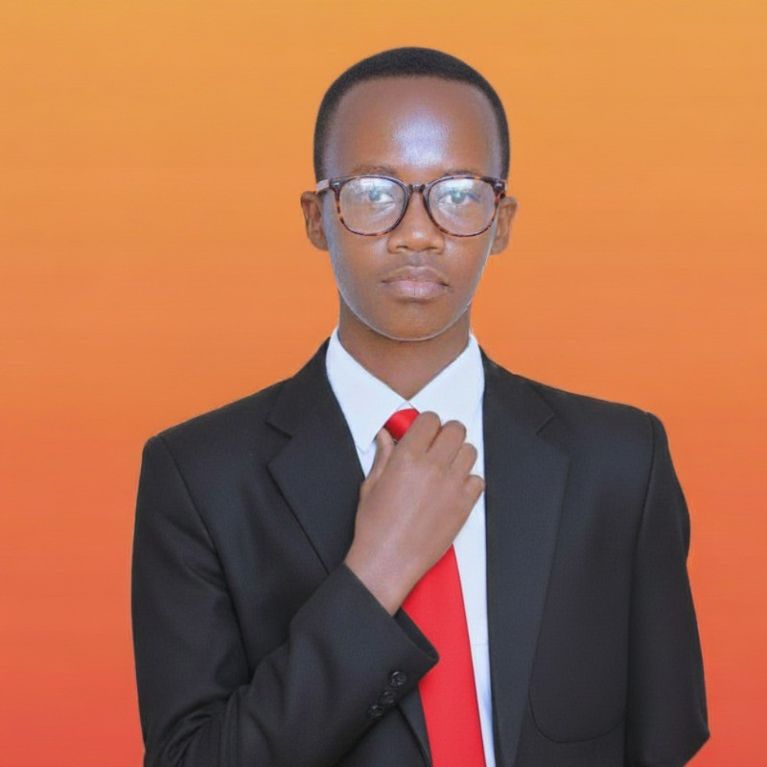
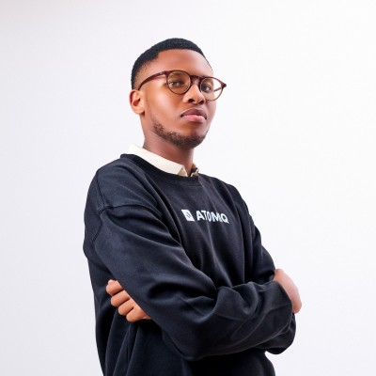
THE TEAM
Built by Founders Who Lived the Problem.
Fredrick Njoroge Kariuki
Axel Karambizi
Co-Founder & Builder
Co-Founder & Growth
IB Student · M-Pesa Foundation Academy
Harvard AI Bootcamp 2025
3× AwardX Finalist
Built SomaVilivyo solo — 67 edge functions
17 years old
AwardX East Africa Winner 2025
Founder, LIBBLIO (500+ users, Rwanda)
National AI Hackathon Winner 2025
iLEAD Africa Leadership Programme
DINAO Investment Fund Intern
ADVISOR · Tonee Ndungu — Founder, Kopo Kopo & Kytabu · East Africa's foremost EdTech & payments builder
CONFIDENTIAL · SomaVilivyo © 2026

Slide 10
COMPETITIVE MOAT
Why SomaVilivyo.
Not the Others.
SomaVilivyo
Khan Academy
Google Learn
Generic EdTech
CBC-native curriculum
✓
✗
✗
✗
Works offline / feature phone
✓
✗
✗
✗
M-Pesa / local payments
✓
✗
✗
Partial
KES 300/mo pricing
✓
Free
Free
KES 2,000+
Swahili + English
✓
English only
✗
✗
Our moat: CBC specificity + offline-first + East African payment rails. No one is building this combination.
CONFIDENTIAL · SomaVilivyo © 2026

Slide 11
SomaVilivyo is already happening.
This investment accelerates what's inevitable.
70 students. 380 courses. KES 300 price point validated.
Tonee Ndungu advising. Platform live. Ask: $3,000 revenue share.
somavilivyo.com
info@somavilivyo.com
+254 778 368 909
CONFIDENTIAL · SomaVilivyo © 2026 · Fredrick Kariuki & Axel Karambizi

Slide 12
ROADMAP
"Months" indicate cumulative holiday time, not calendar months. 1 Roadmap Month = 31 school holiday days.
From $3,000 to $276K ARR.
Here's the 12-Month Plan.
Month 1–2
Month 3–5
Month 6–9
Month 10–12
Platform Rebuild
B2C Growth Sprint
School Subscriptions
County Licensing
· Atomiq team delivers full frontend + backend
· School WhatsApp groups + TUKO press campaign
· Launch KES 5,000 / 20-student school bundle
· Pitch County Education Directorates
→
→
→
· Admin dashboard + payment reconciliation live
· Hummingbird Publishers co-marketing MOU activated
· Pilot 10 schools in Nairobi + Nakuru counties
· Institutional licensing at KES 50K / county cluster
· M-Pesa STK Push integrated for KES 300 billing
· Referral loop: 1 student → 3 classmates
· Teacher dashboard for progress tracking
· Seed round fundraise ($150K–$300K)
Start Date: April 7, 2026
End Date: ~November 14, 2026
Start Date: ~November 15, 2026
End Date: ~August 19, 2027
Start Date: ~August 20, 2027
End Date: ~November 20, 2027
Start Date: ~November 21, 2027
End Date: ~January 21, 2028
Target: 200 paying students
Target: 1,000 paying students
Target: 3,000 students
Target: 10,000 students · $276K ARR
Revenue-share repayment begins at Month 3 · Full repayment projected by Month 8 at 1,000 students
CONFIDENTIAL · SomaVilivyo © 2026

